Slide 1

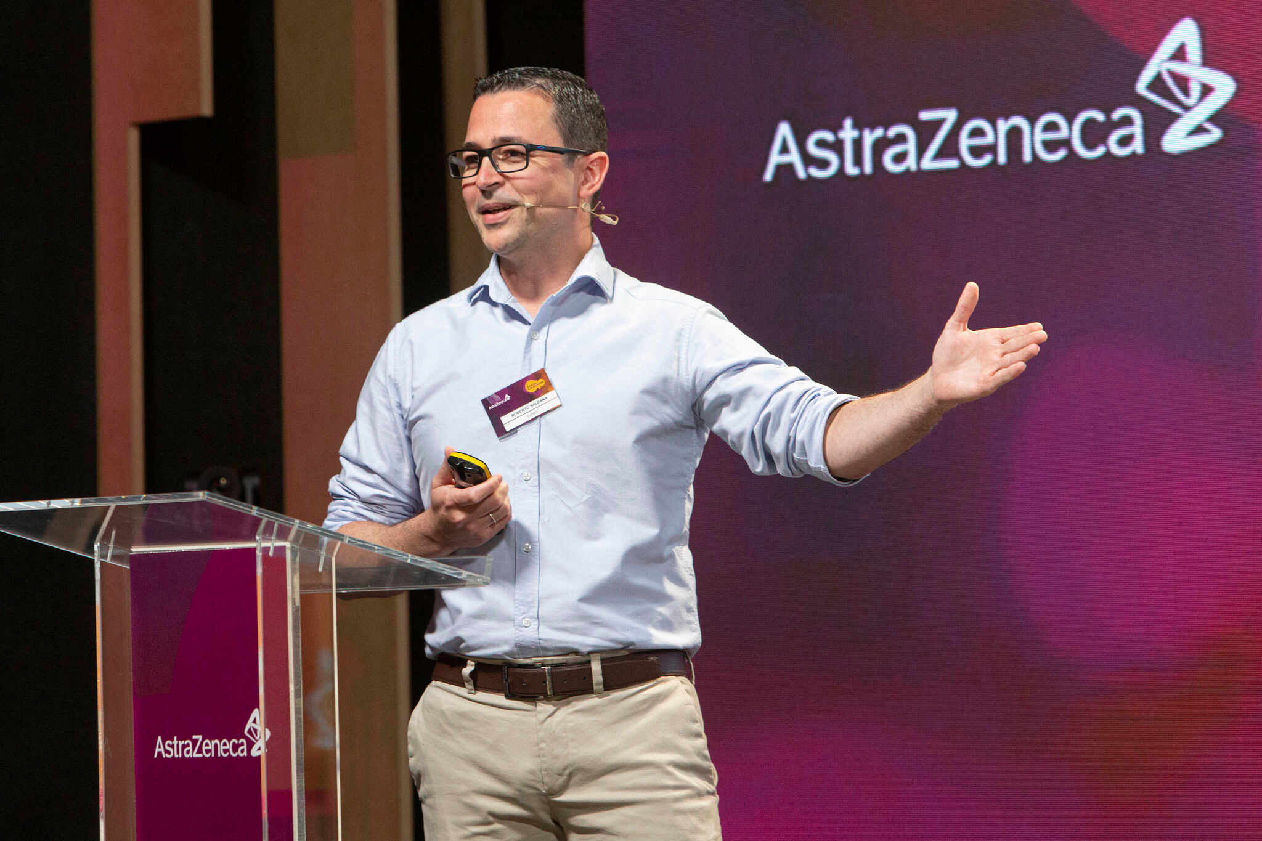
unequal acces
to IBD care in Europe
Roberto Saldaña
EFCCA
Innovation & Patient engagement
Mexico, 17 May 2024

Slide 2
Setting the scene...
More clinical research, better access to treatment and quality of care.
​

Slide 3
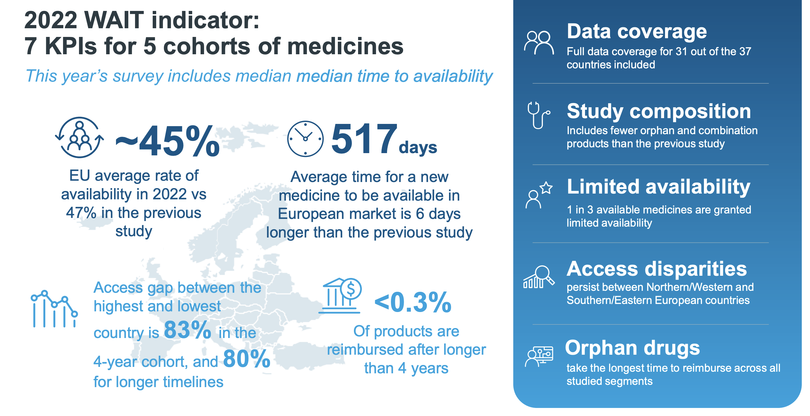

Slide 4
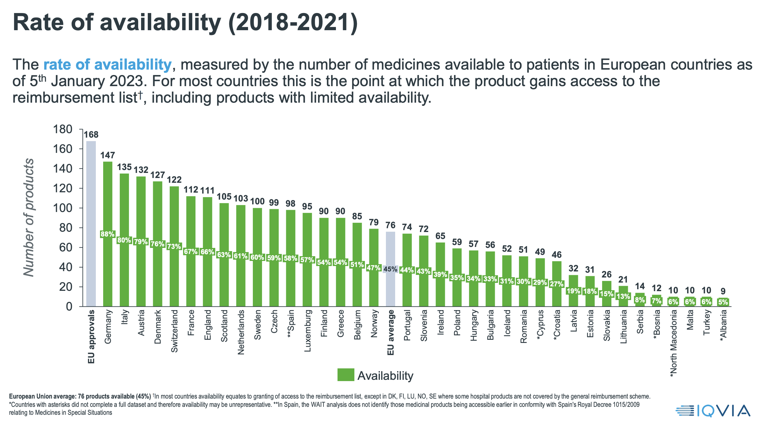

Slide 5
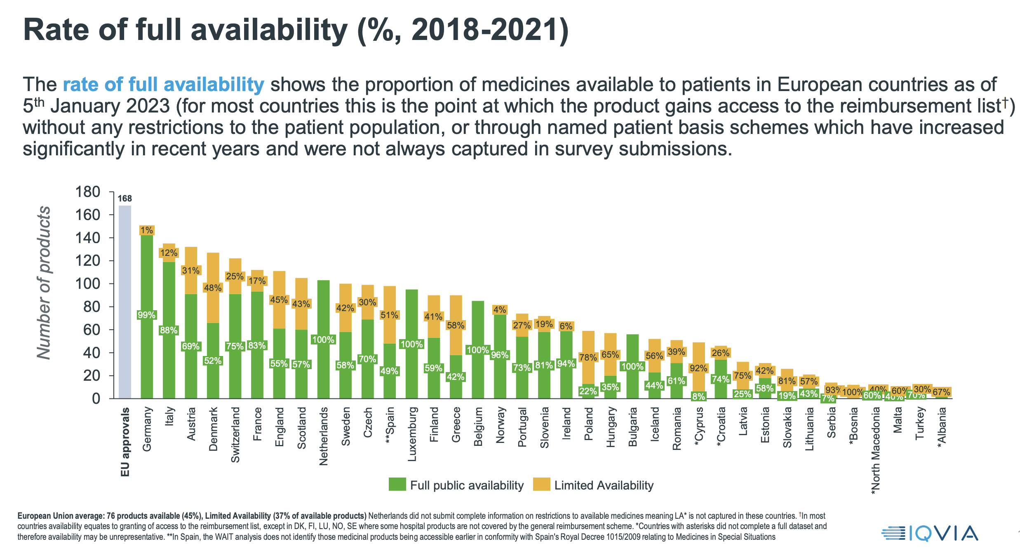

Slide 6
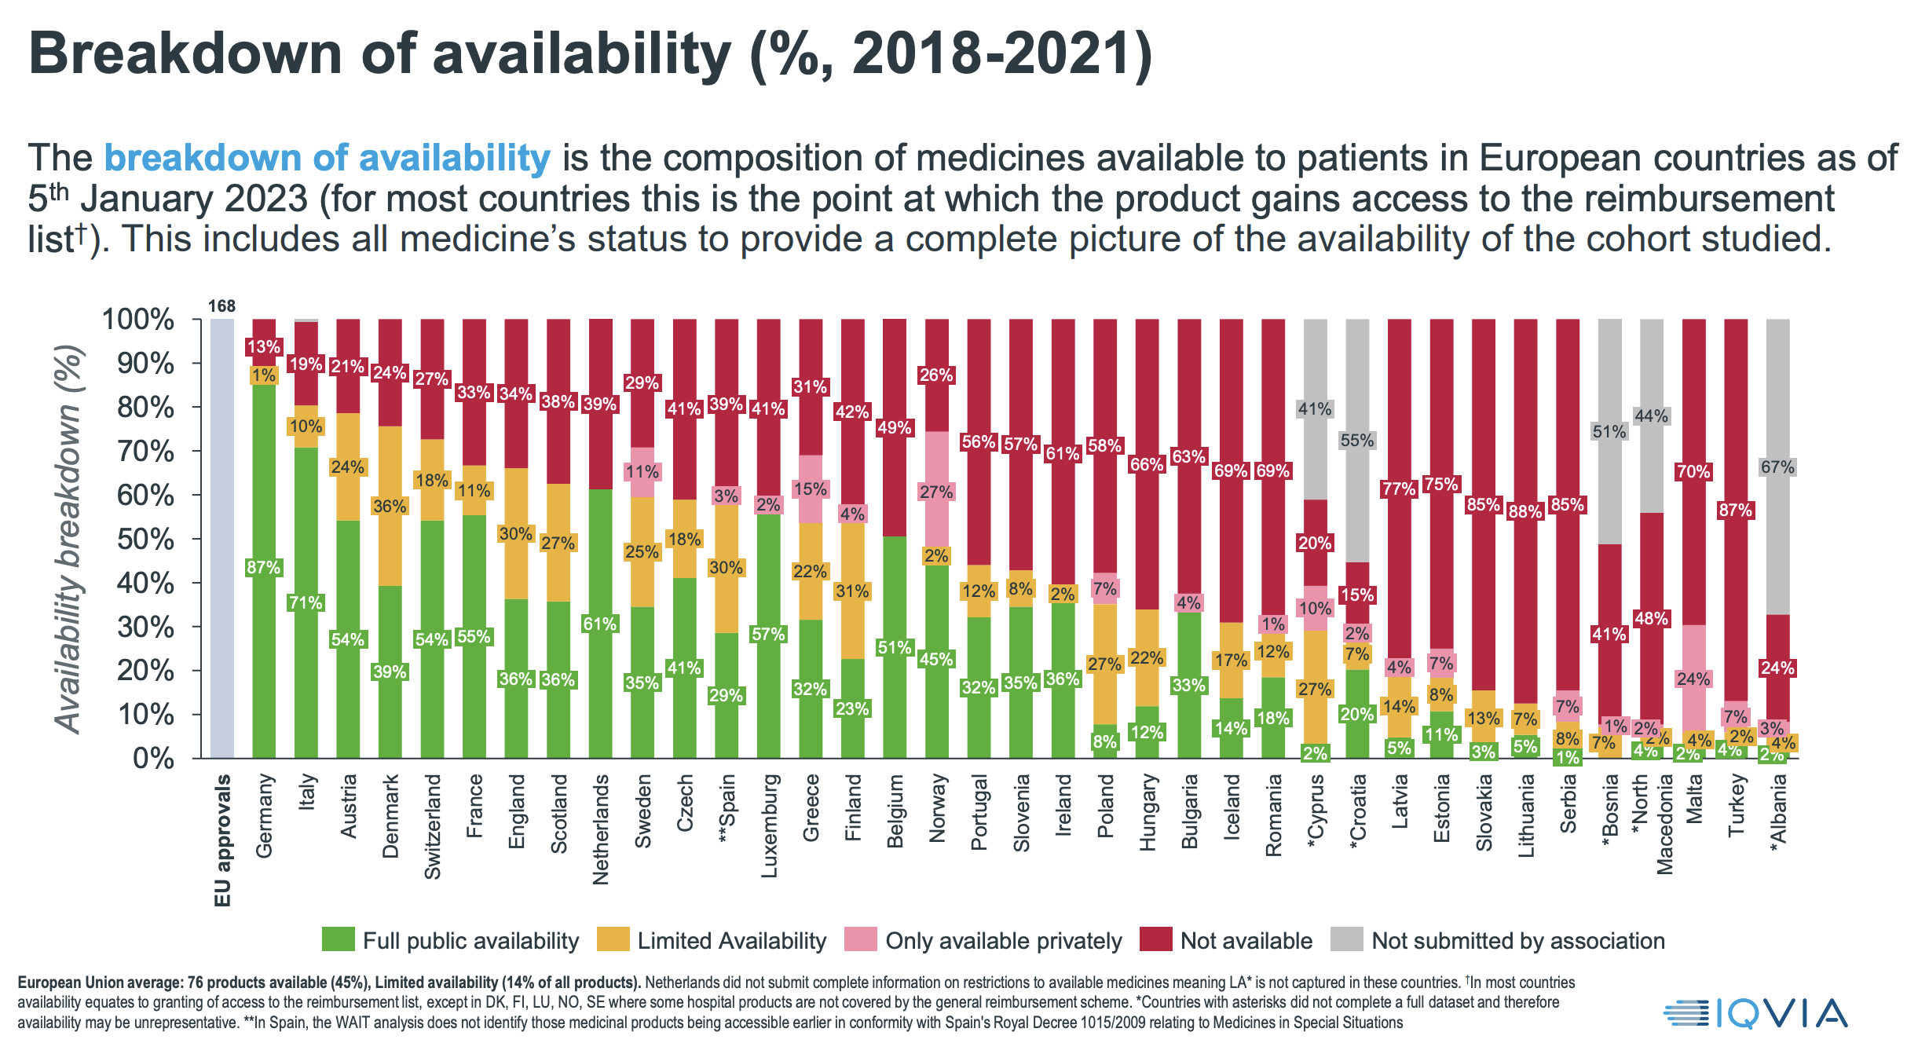

Slide 7
Is it also happing in IBD?

Slide 8
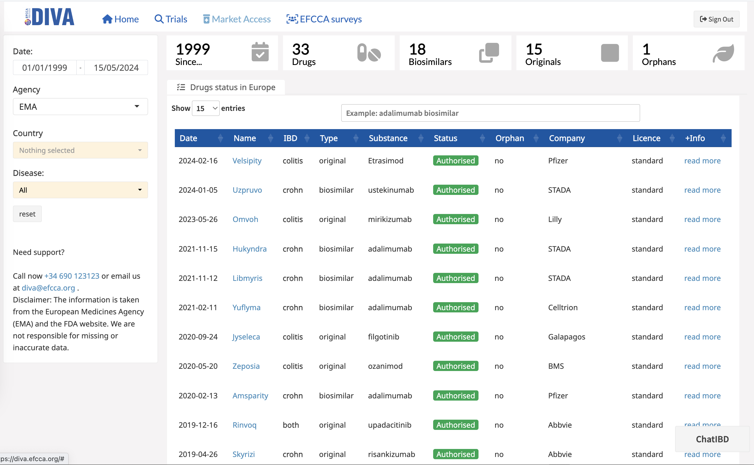

Slide 9
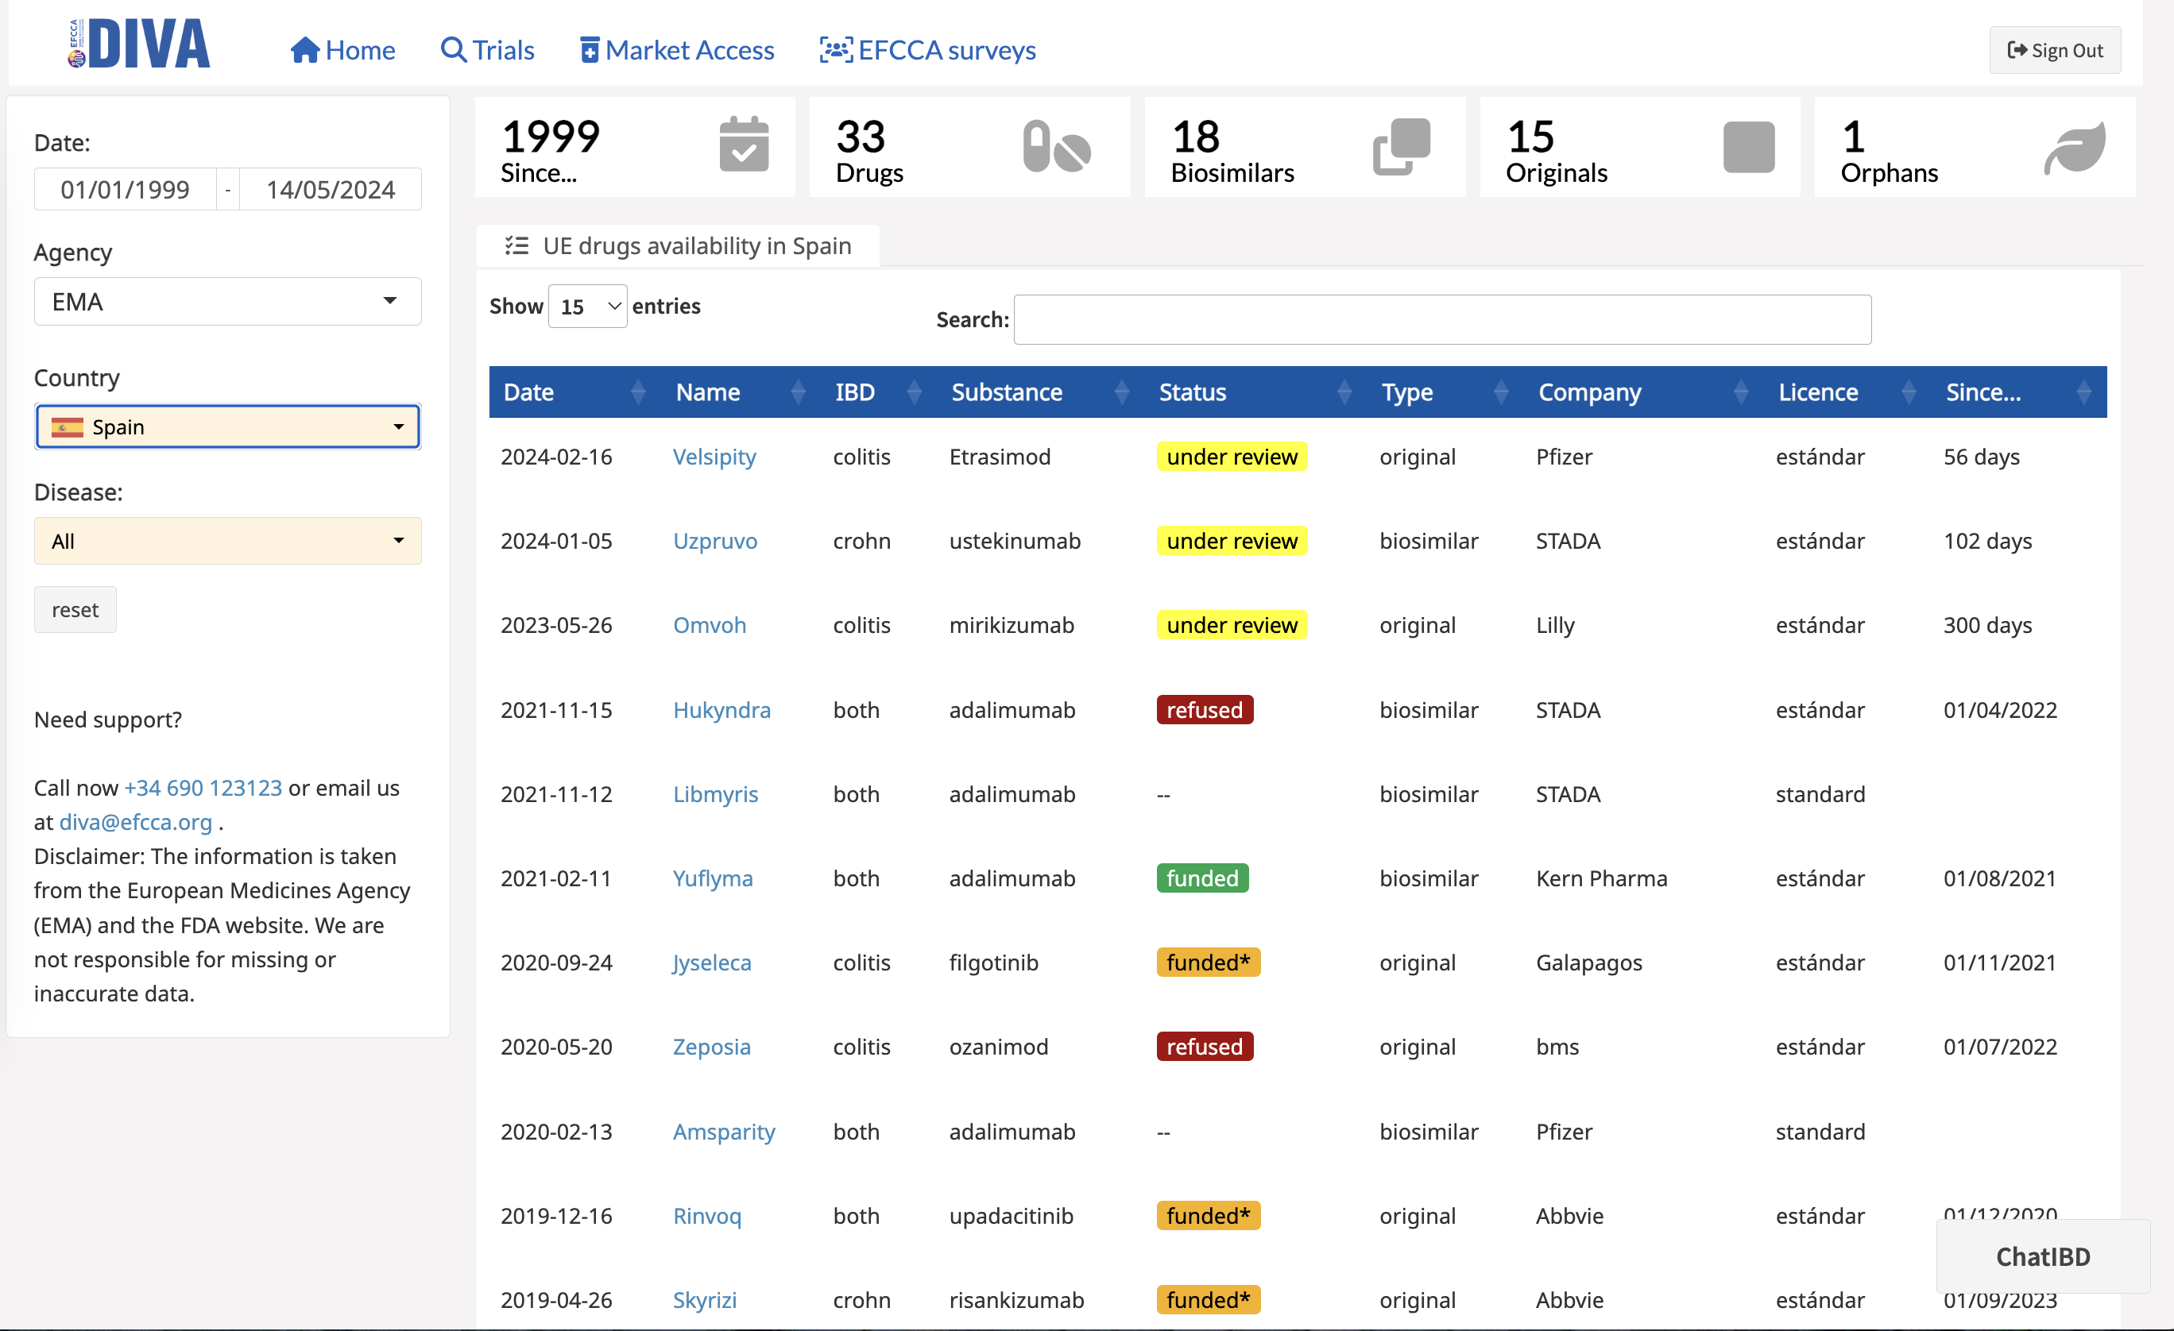

Slide 10
Innovative products are
not the only ones affected.

Slide 11
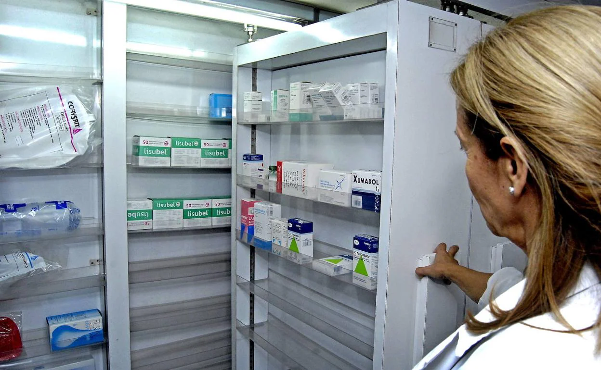

Slide 12
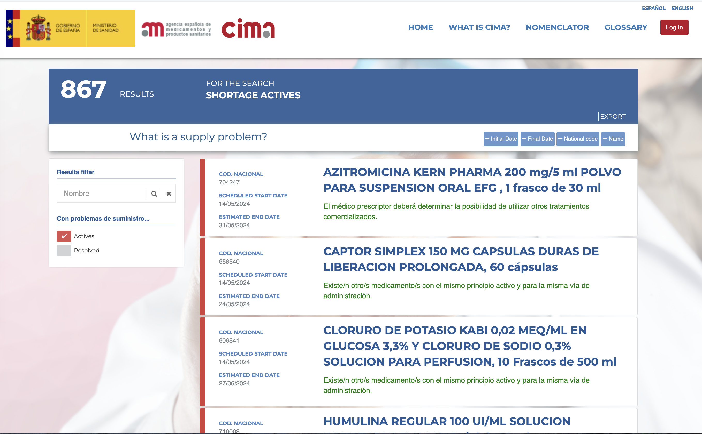

Slide 13
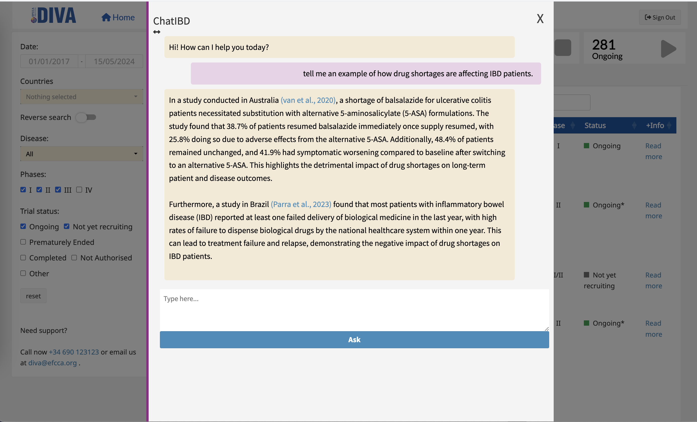

Slide 14
Let's talk about
what is happening

Slide 15
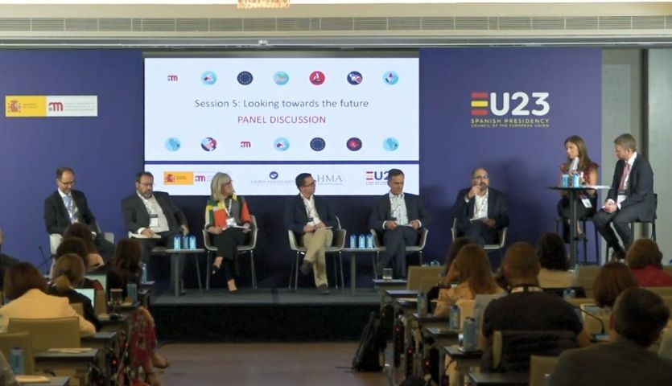

Slide 16
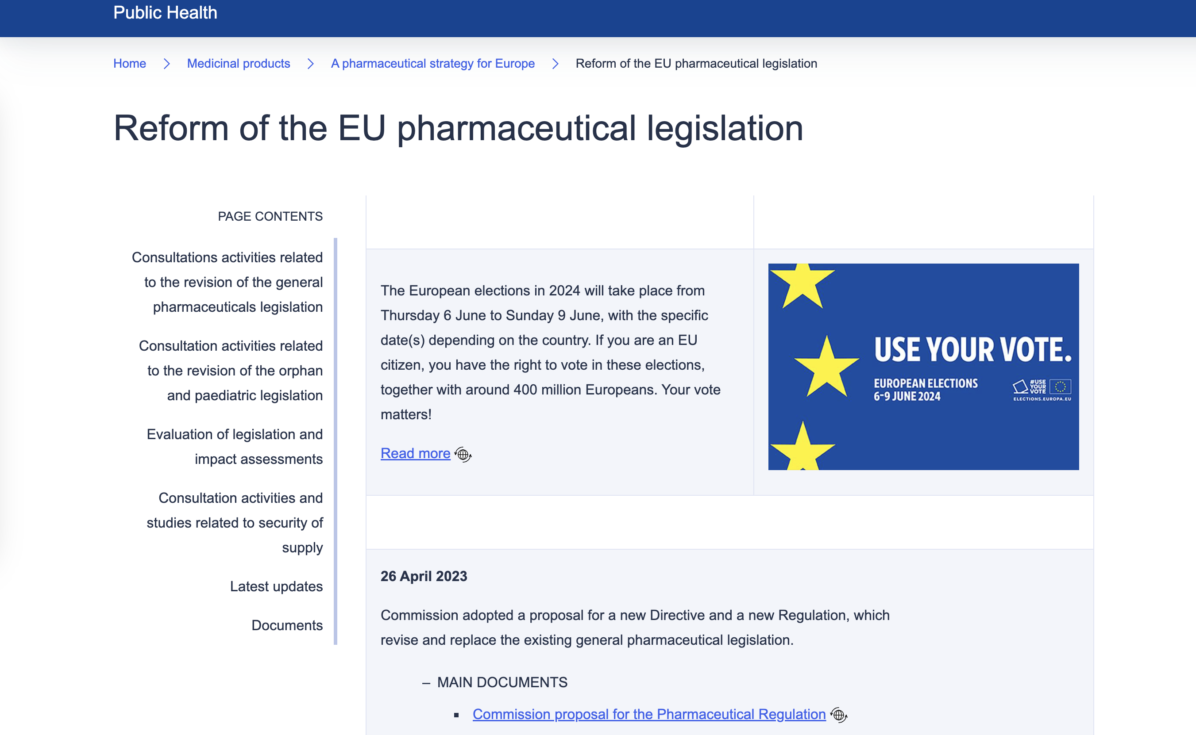

Slide 17
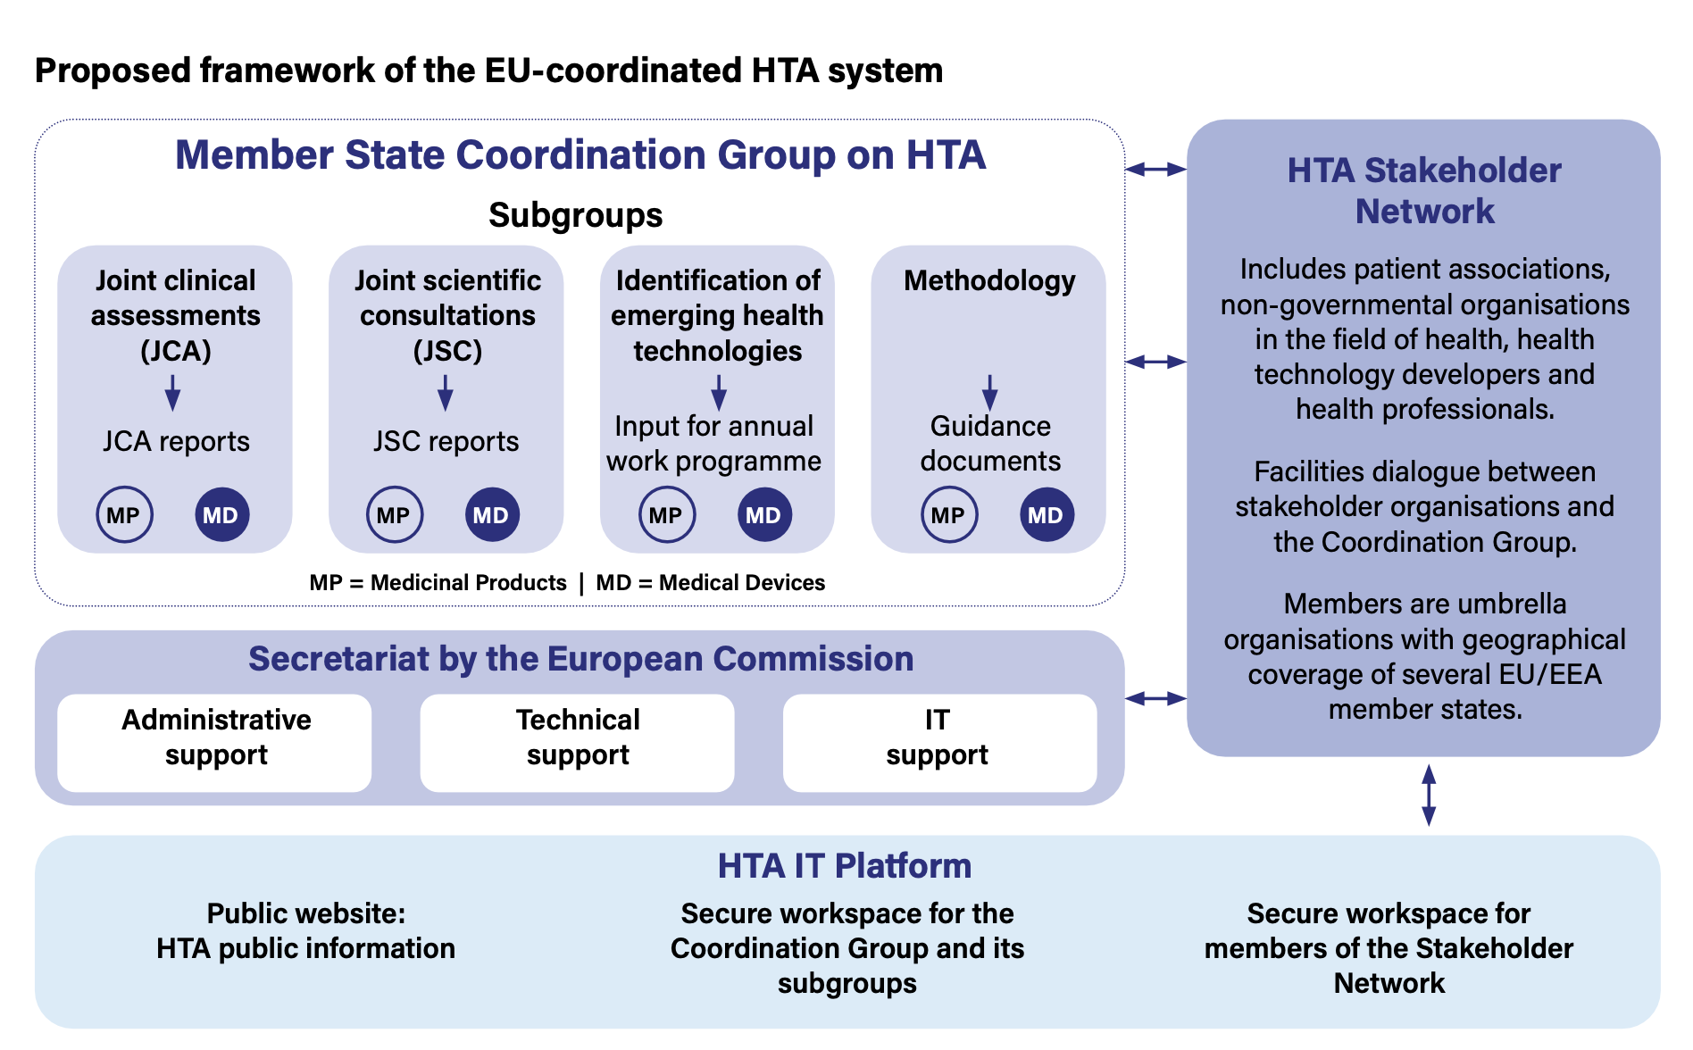

Slide 18
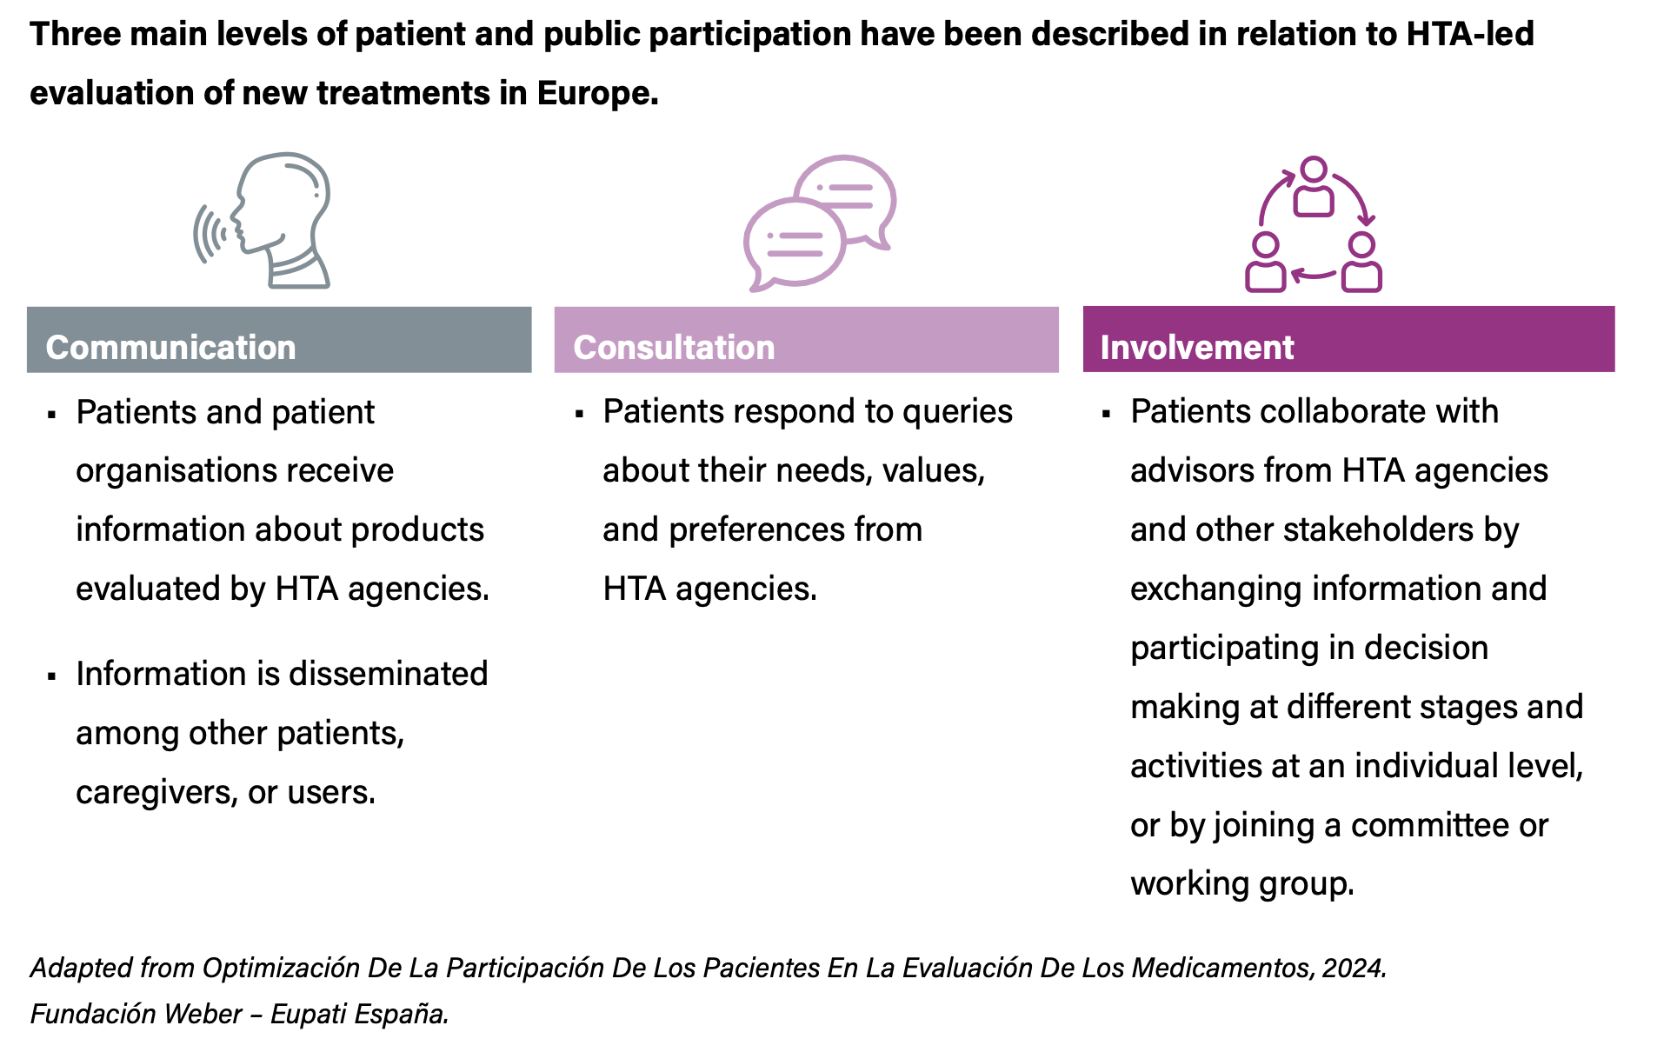

Slide 19
Thank you!
www.efcca.org

