Slide 1
Crohn’s and Colitis Canada
IFCC Presentation
May 2024

Slide 2
We aspire to cure Crohn’s disease and ulcerative colitis and to improve the lives of everyone affected by these diseases.
Our Promise
Notes:
Crohn’s and Colitis Canada was founded in 1974 by concerned parents of children living with Crohn’s disease and ulcerative colitis.
We are on a relentless journey to • Find a cure for these lifelong diseases • Improve the quality of life of everyone in Canada affected by these diseases
We have a rich legacy of research with more than 140 million dollars invested to date
Outside of government, we are the largest funder of IBD research in Canada

Slide 3
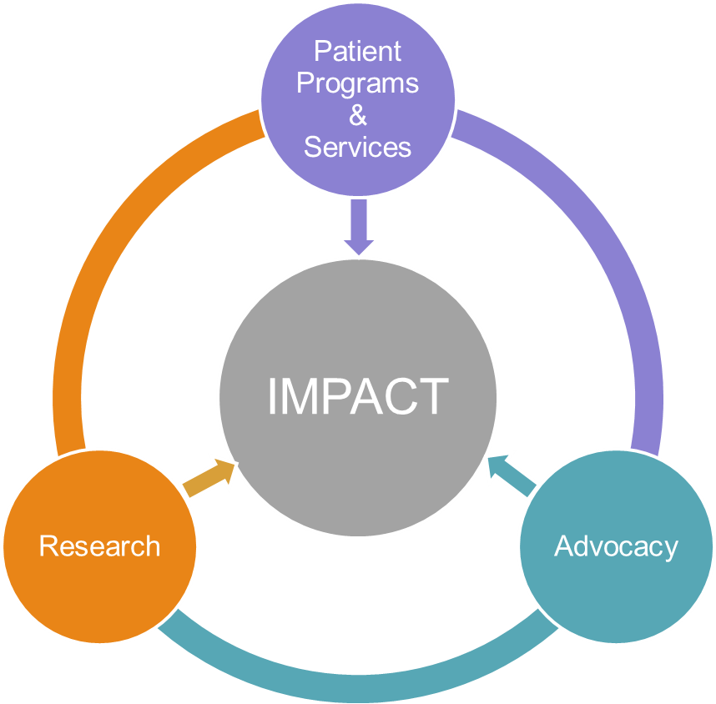
Developing Mission Priorities
Needs/Gaps
National Survey (2-3 years)
Polls
Education Events
Help Centre
Impact of IBD Reports
Focus Groups
Partners
Landscape
Resources
+
=
Landscape
Assessment
Resource
Requirements
n > 2,000

Slide 4
2008
2012
2018
2021
2023

Slide 5
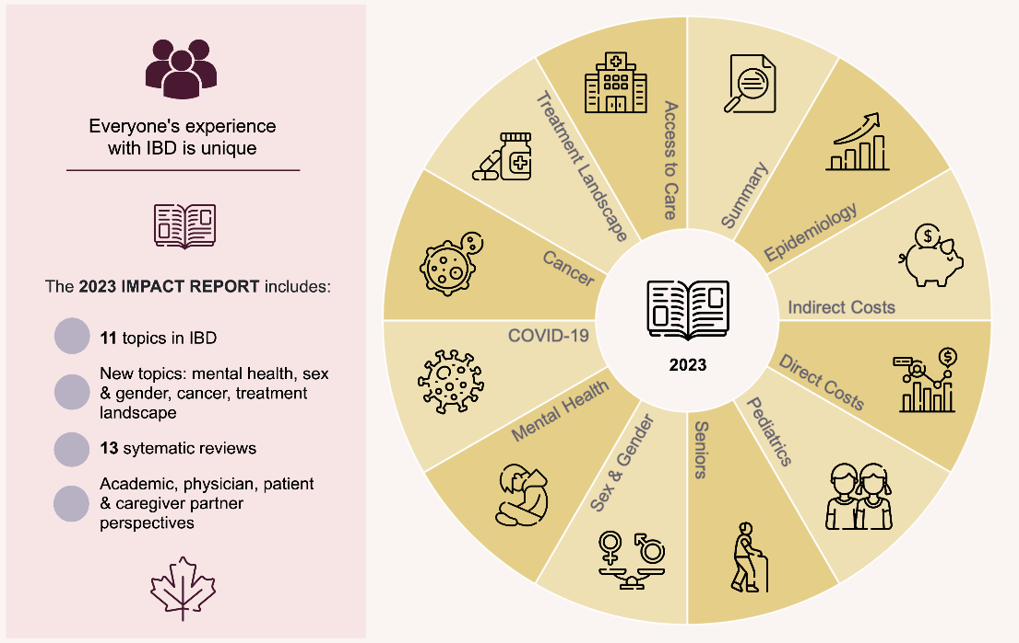
2023 Inflammatory Bowel Disease in Canada
Notes:
Having achieved a basic understanding of inflammatory bowel disease, I’d like at this point to provide you with a brief overview of our report 2023 Impact of Inflammatory Bowel Disease in Canada. This is the fifth in a series of reports that have been published at approximately four-year intervals since 2008. Written by leaders in our scientific community to Crohn’s and Colitis, the report features 12 sections, 13 systematic reviews, more than a hundred key findings and 70+ recommendations.

Slide 6
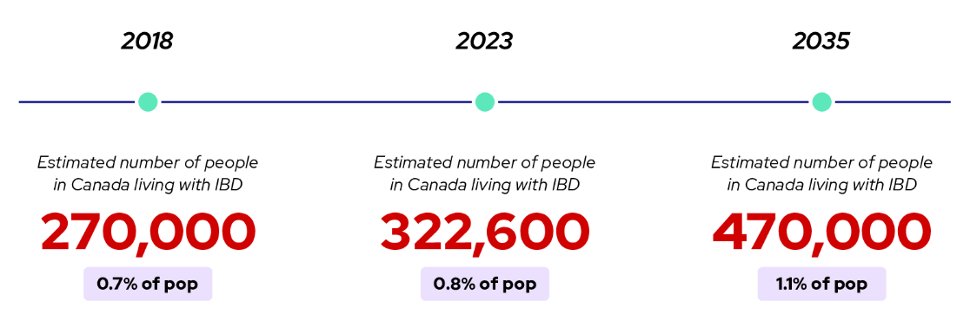
Key findings
Biggest increases in new diagnoses are being seen in children and South Asian populations
Pediatric IBD rates now among highest in the world
Seniors are the most rapidly growing group since people with IBD are living longer due to better therapies, and our population is aging
Notes:
In the short space of time since our last report in 2018, we’ve seen the proportion of Canadians living with IBD increase from .7% in to .8%. By 2035, it’s expected that 1.1% of the population, some 470,000 Canadians, will live with IBD. New diagnoses are also increasing with someone newly diagnosed with IBD every 48 minutes. By 2035, it will be one every 38 minutes. The biggest increases in new diagnoses are being seen in children as well as Canada’s South Asian population. The most rapid growth though is being seen in the seniors population due to the high growth rate in Canada’s senior population and the fact that people with IBD are living longer due to better, more effective medications.

Slide 7
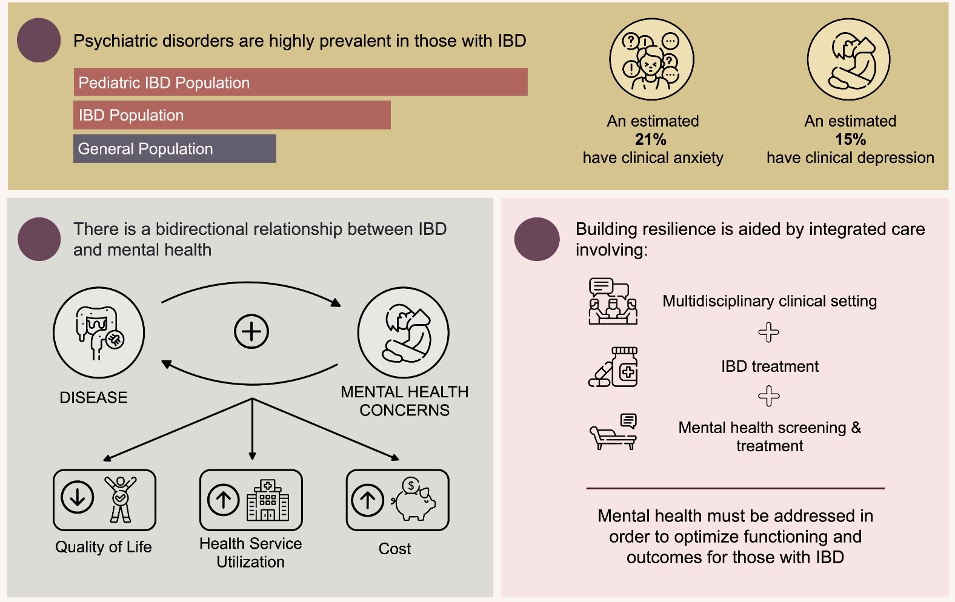
Key findings
Notes:
The report also found that anxiety, depression and other mental health concerns are increasingly associated with IBD with psychiatric disorders 1.4-2 times as common among people with IBD than in the general population and more common still among the adolescent population. An estimated 21% of Canadians with IBD have clinical anxiety and an estimated 15% have clinical depression.

Slide 8
Canada’s Healthcare System for Crohn’s and colitis
Paediatric Care
Centralized at major urban academic-based paediatric hospitals (99% of children)
Multidisciplinary care
Standards of care based on latest evidence and guidelines
Adult Care (≥ 18 years)
Decentralized, non-multidisciplinary care
80% of adults see gastroenterologists practising in community clinics

Slide 9
Gaps in Care
Long wait times to see specialist
Standards of care inconsistent (urban-academic hospitals vs community clinics)
E.g. chronic use of steroids
Lack of resources (e.g. nurses) adds to the burden of community practitioners
Rural-urban inequities in quality and access to care (travel time, taking time off from work/school, out of pocket expenses)
Challenges in transitioning from paediatric care (multidisciplinary) to an adult care (single provider) model

Slide 10
How is Crohn’s and Colitis Canada Addressing these Gaps?
Research, Patient Programs, Advocacy

Slide 11
Promoting Access & Care through Centres of Excellence (PACE)
Promoting Access & Care through Centres of Excellence (PACE) brings together leading IBD Centres of Excellence to advance best practices and elevate the standard of care for patients with IBD.
PACE OBJECTIVES
01 Address gaps in care
02 Improve health outcomes
03 Develop solutions that can create changes in the public healthcare system
Notes:
Launched in the Spring of 2016, Crohn’s and Colitis Canada’s PACE program was a unique collaboration in Canada specifically formed to advance Crohn’s and Colitis care.
In 2016: Collaboration included 5 IBD centres and 6 Gis
Lead: Dr. Geoffrey Nguyen (Mount Sinai Hospital)
UAlberta: Dr. Karen Kroeker (Dr. Richard Fedorak)
UCalgary: Dr. Remo Panaccione & Dr. Cynthia Seow
McMaster: Dr. John Marshall & Dr. Neeraj Narula
McGill: Dr. Alain Bitton & Dr. Waqqas Afif
As a priority-driven research program, PACE aims to integrate research and patient care in order to address the biggest healthcare gaps that impact Canadians living with IBD
Improving rural/remote access to IBD care;
Standardize care decisions;
Monitoring IBD health using digital tech;
Improving clinical care processes
In 2021, we have expanded the network to include 9 IBD Centres across Canada - 12 GIs, a psychologist and an implementation scientist.
Expanded successful pilots from Phase 1
Added new pilot programs to address priority needs (transitions in IBD care; mental health and diet)
Phase 2: One stop shop digital platform

Slide 12
PACE & The IBD Patient Journey
Access to care should be:
01 Timely
02 Equitable
03 High quality
Notes:
Launched in the Spring of 2016, Crohn’s and Colitis Canada’s PACE program was a unique collaboration in Canada specifically formed to advance Crohn’s and Colitis care.
In 2016: Collaboration included 5 IBD centres and 6 Gis
Lead: Dr. Geoffrey Nguyen (Mount Sinai Hospital)
UAlberta: Dr. Karen Kroeker (Dr. Richard Fedorak)
UCalgary: Dr. Remo Panaccione & Dr. Cynthia Seow
McMaster: Dr. John Marshall & Dr. Neeraj Narula
McGill: Dr. Alain Bitton & Dr. Waqqas Afif
As a priority-driven research program, PACE aims to integrate research and patient care in order to address the biggest healthcare gaps that impact Canadians living with IBD
Improving rural/remote access to IBD care;
Standardize care decisions;
Monitoring IBD health using digital tech;
Improving clinical care processes
In 2021, we have expanded the network to include 9 IBD Centres across Canada - 12 GIs, a psychologist and an implementation scientist.
Expanded successful pilots from Phase 1
Added new pilot programs to address priority needs (transitions in IBD care; mental health and diet)
Phase 2: One stop shop digital platform

Slide 13
PACE: Piloting Solutions
MyGut
IBD Telemedicine Network
Piloting the MyGut mobile app & Provider Portal at two academic hospitals
Piloting telemedicine in one province
Standardizing IBD Care
Youth to Adult Care
Clinical Care Pathways (CCP) in one province
Transitioning youth to the adult care model
Notes:
One Go-to Resource for Patients & Providers
Phase 2 – focus on consolidating many of the digital solutions that were initially developed into a "one stop shop" - housing the CCP, TM, MyGut and integraiton of other available digitla health data
Priority focus – increase adoption of PACE digital health solutions by both academic and COMMUNITY practitioners
Canadians with IBD have been asking for one "go-to" resource to manage their IBD
- Patients can take their records and resources wherever they go in Canada
The PACE digital health solution will offer the one go-to resource that patients have been asking for to manage their Crohn’s and colitis. Since it is accessed digitally, patients will be able to take their records and resources wherever they go in Canada.
- Providers can have access to full historical records via Provider Portal - Holistic view of their patients, with the ability to monitor patients health between clinic visits
- Providers can have access to IBD care resources via Provider Portal
Their new provider will also have access to the full historical records via the Provider Portal.
For providers, the platform will give them a holistic view of their patients, with the ability to monitor their patients’ health in between clinic visits
Rich holistic patient data
- inform CCC's patient, research and advocacy priorities

Slide 14
Mental Health/Diet Support
Mental health and diet screening tool
MyGut
National IBD Telemedicine Network
Piloting the MyGut mobile app & Provider Portal in community clinics ("hub and spoke" model)
Piloting the national telemedicine hubs at five Canadian IBD Centres of Excellence
ONE STOP SHOP
Standardizing IBD Care
Youth to Adult Care
Nationalizing the Clinical Care Pathways (CCP)
Transitioning youth to adult care model
Notes:
One Go-to Resource for Patients & Providers
Phase 2 – focus on consolidating many of the digital solutions that were initially developed into a "one stop shop" - housing the CCP, TM, MyGut and integraiton of other available digitla health data
Priority focus – increase adoption of PACE digital health solutions by both academic and COMMUNITY practitioners
Canadians with IBD have been asking for one "go-to" resource to manage their IBD
- Patients can take their records and resources wherever they go in Canada
The PACE digital health solution will offer the one go-to resource that patients have been asking for to manage their Crohn’s and colitis. Since it is accessed digitally, patients will be able to take their records and resources wherever they go in Canada.
- Providers can have access to full historical records via Provider Portal - Holistic view of their patients, with the ability to monitor patients health between clinic visits
- Providers can have access to IBD care resources via Provider Portal
Their new provider will also have access to the full historical records via the Provider Portal.
For providers, the platform will give them a holistic view of their patients, with the ability to monitor their patients’ health in between clinic visits
Rich holistic patient data
- inform CCC's patient, research and advocacy priorities

Slide 15
“One Stop Shop”: Hub & Spoke Model

Slide 16
Thank You

