Slide 1
Paediatric IBD in Australia: Patient Experience and Audit
Notes:
Thank you for the opportunity today to speak to you about Paediatric IBD in Australia. I’d like to pay my respects to the people of Mexico who are hosting this meeting and to EFFCA for organising the global meeting for World IBD Day on 19 May.

Slide 2
Disclosures
Project funded by Australian Government Department of Health
No other disclosures
Notes:
Project funded by the Australian government

Slide 3
At CCA we dream of a future free of Crohn’s and colitis
Empowering People
to Live
Fearlessly
While we help
Search for
a
Cure
https://www.crohnsandcolitis.com.au/

Slide 4
CCA Ambition 2026
Provider of valued services and products to support the IBD community across the lifespan
Driver of research that progresses the search for a cure
A fearless and frank communicator, advocating for system change, improved information and education
A trusted and influential organisation respected by the IBD community, philanthropy, health and medical industry and government
Sustainable funded and financially stable with a diverse and wide community of support
Notes:
Huge Ambition of where we aim to be in 2026

Slide 5
Australia- Sydney Harbor- World IBD Day
Notes:
Favourite image of World IBD Day in Australia – Opera House- Sydney Harbor Bridge and many buildings in the city

Slide 6
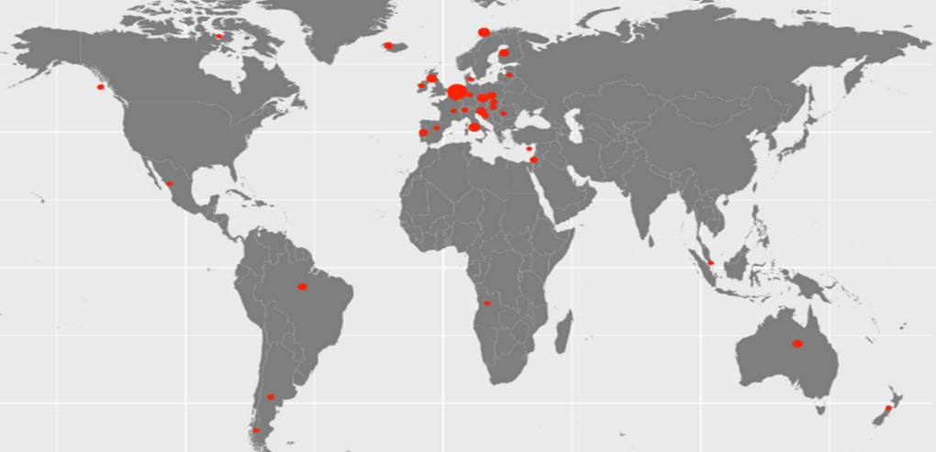
Australia- Down Under

Slide 7
IBD National Action Plan
Notes:
The IBD NAP was developed in 2019 by CCA in collaboration with the key stakeholders in IBD and was adopted by the Australian Government.
One of the priority recommendations focused specifically on the need for “Increased investment in research for children and adults with IBD.”
It recommended a repeat audit of paediatric care to measure change and inform future quality improvement.

Slide 8
Paediatric Project
Project Advisory Committee
Dr Ed Giles (Chair) | Monash Health
A/Prof George Alex | Royal Children's Hospital Melbourne
Dr Chris Burgess | Queensland Children's Hospital
Deirdre Burgess | John Hunter Children's Hospital
Dr Shoma Dutt | The Children’s Hospital at Westmead
Subhadra Evans | Deakin University
Dr Nitin Gupta | Sydney Children’s Hospital, Randwick
Dr Paul Hammond | Women’s & Children's Hospital (Adelaide)
Elliot Harris | Living with IBD
Helen Jurgens | Women’s & Children's Hospital
Prof Antonina Mikocka-Walus | Deakin University
A/Prof Ram Nataraja | Monash Health
Dr Scott Nightingale | John Hunter Children's Hospital
Professor Paul Pavli | Canberra Hospital
Peita Pittella | Living with IBD
Dr Ajay Sharma | Hollywood Private Hospital, Joondalup Health Campus, Joondalup Private Hospital
Merran Spargo | The Children's Hospital at Westmead
Dave Skvarc | Deakin University
Project team
Leanne Raven | Crohn’s & Colitis Australia
Wayne Massuger | Crohn’s & Colitis Australia
Stephan Moller | Crohn’s & Colitis Australia
Juliet Matskarofski | Crohn’s & Colitis Australia
Australian Government Grant opportunity
CCA confirmed the support of the Gastroenterological Society of Australia (GESA):
GESA IBD Faculty
GESA Paediatric Network.
Experience study and audit of care
Notes:
A grant for the repeat audit was offered, and CCA supported by the GESA IBD Faculty and Paediatric network were successful in winning the grant. An advisory committee was formed with key medical staff from all of the major paediatric centres in Australia, nursing, allied health, psychology and importantly young adults living with IBD.

Slide 9
Paediatric IBD Quality of Care project
Patient Experience Survey
Online Survey
Family Interviews
2022
PBS
10% data
2015-2021
Hospital Audit
Organisational Survey
Clinical Audit
2021
AIHW
National pIBD Hospital Activity
2021
Notes:
The Paediatric IBD QoC project has a number of data sources. The main one I will speak about today is a national patient experience survey which included an online survey and family interviews. The others have not been released yet until 30 May at a special launch event in Parliament House Australia- but I will give a quick overview at the end.

Slide 10
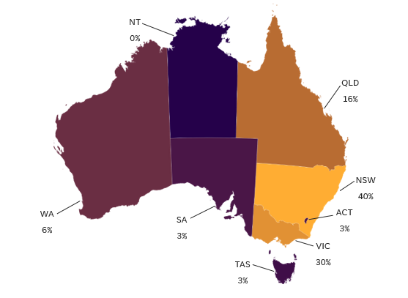
Experience Survey Results
297 responses, n= 266 included
Age Mean (SD) 14.3 yrs (3.2)
Female 49.6%
English main language 94.7%
Students 78.8%
Living with 2 parents 73.3%
CCA Member 27.8%
National distribution
Notes:
297 respondents, resulting in 266 included records. 45 youth (16-17 years) with IBD participated directly and 221 were reported on by their parent/carer.
There was a reasonably representative spread of ages of the youth reported with a mean of 14.3 years
There was a even split of male and female youth, with 91.6% living in either a major Australian city or an inner regional area. Participants were from each state and the ACT and approximately matched general population distribution.
The majority spoke English as their main language at home (94.7%), and around one-quarter (27.8%) indicated a current CCA membership. Data from 16/17-year-old respondents showed that most were living with two parents (73.3%), students (77.8%), and relatively few were employed casually/part-time..

Slide 11
Experience Survey Results
Clinical characteristics
 | n (%)
Diagnosis
Crohn's disease | 151 (56.8%)
Ulcerative colitis | 96 (36.1%)
IBD unclassified | 19 (7.1%)
Years diagnosed - Mean (SD), range (years) | 3.5 (3.1), 0-17
Manitoba Index - active/inactive
Active | 168 (66.9 %)
PRO3 - Crohn's disease only (n = 141)
Active | 58 (41.2%)
PRO2 - ulcerative colitis only (n = 90)
Active | 44 (48.9%)
Notes:
Some of the clinical characteristics here. The youth had been diagnosed with IBD for an average of 3.5 years with Crohn’s disease being the most common diagnosis (56.8%). Self-reported disease activity suggested an active IBD state in approximately two-thirds of youth via the Manitoba Index whereas the subtype-specific disease activity measures suggested fewer with active disease 41.2% of youth with Crohn’s disease (PRO3) and 48.9% of those with ulcerative colitis (PRO2). We think its reasonable to summarise as almost half had active disease.

Slide 12
Experience Survey Results
Clinicians available in my treating team
Primary medical management over the previous year
 | n (%)
Primary past-year IBD manager
Public outpatient clinic | 195 (73.9 %)
Private specialist | 47 (17.8 %)
Other (please specify) | 15 (5.7 %)
GP | 4 (1.5 %)
IBD managed in a paediatric clinic
Yes | 224 (85.5 %)
No | 28 (10.7 %)
Unsure | 10 (3.8 %)
Non-paediatric management clinic
Adult gastroenterology clinic or adult IBD clinic | 16 (53.3 %)
Specific transition young adult clinic | 3 (10.0 %)
Other | 11 (36.7 %)
Notes:
Only half of respondents had access to an IBD nurse, the same for dietitians and only a quarter had access to a psychologist in their team.
Care was managed over the previous year mostly by in a public outpatient clinic (74%) and around 18% by a private specialist.
Then looking at access to paediatric specialists (public or private) 85.5% had access to peadiatric clinic or specialist, the others have access to adult 10% , transition or other.

Slide 13
Experience Survey Results
 | n (%) | Prescriber | n (%)
Steroids
Yes, I am currently taking them | 26 (9.8 %) | Gastroenterologist | 104 (96.3 %)
Yes, but I am no longer taking them | 82 (31.1 %) | GP | 3 (2.8 %)
No | 152 (57.6 %) | Other (Please enter) | 1 (0.9 %)
Unsure | 4 (1.5 %)
Immunomodulators
Yes, I am currently taking them | 185 (70.1 %) | Gastroenterologist | 195 (99.0 %)
Yes, but I am no longer taking them | 12 (4.5 %) | Other (Please enter) | 2 (1.0 %)
Yes# | 1 (0.4 %)
No | 59 (22.3 %)
Unsure | 7 (2.7 %)
Biologics
Yes, I am currently taking them | 142 (53.8 %) | Gastroenterologist | 143 (100.0 %)
Yes, but I am no longer taking them | 2 (0.8 %)
Yes# | 1 (0.4 %)
No | 112 (42.4 %)
Unsure | 7 (2.7 %)
#n = 1 did not provide response for current use of the medication.
Medication use previous 12 months
(>6 weeks use)
National distribution
Notes:
Medication use was surveyed in relation to IBD team prescribers. The most common medications used for over six weeks in the previous 12 months were immunomodulators (75.0%), biologics (54.9%), and steroids (40.9%). Almost all of these were prescribed by a gastroenterologist, just 3% of steroids prescribed by a GP.

Slide 14
Experience Survey Results
 | n (%) | Prescriber | n (%)
Opiates
Yes, I am currently taking them | 6 (2.3 %) | Gastroenterologist | 4 (40.0 %)
Yes, but I am no longer taking them | 5 (1.9 %) | GP | 4 (40.0 %)
No | 250 (94.7 %) | Other (Please enter) | 2 (20.0 %)
Unsure | 3 (1.1 %)
Mental health medications
Yes, I am currently taking them | 23 (8.7 %) | Gastroenterologist | 1 (4.2 %)
Yes, but I am no longer taking them | 2 (0.8 %) | GP | 12 (50.0 %)
No | 237 (89.8 %) | Other (Please enter) | 11 (45.8 %)
Unsure | 2 (0.8 %)
Dietary therapies
Yes, I am currently taking them | 19 (7.2 %) | Gastroenterologist | 47 (94.0 %)
Yes, but I am no longer taking them | 32 (12.1 %) | GP | 1 (2.0 %)
No | 210 (79.5 %) | Other (Please enter) | 2 (4.0 %)
Unsure | 3 (1.1 %)
#n = 1 did not provide response for current use of the medication.
Medication use previous 12 months
(>6 weeks use)
National distribution
Notes:
Less commonly reported were dietary therapies (19.3%), mental health medications (9.5%), and opiates (4.2%). Whilst a small percentage, 8 young people on opiates for more than 6 weeks is a concern.

Slide 15
Experience Survey Results
Inpatient care
The ward you/they were in mainly had patients who were:
Children of all ages 79 (81.4 %)
Adolescents 14 (14.4 %)
Adults 4 (4.1 %)
Seen by an IBD specialist nurse 51.5 %
Seen by a dietitian 49.5%.
Notes:
Looking at Inpatient care, 35.1% had been in hospital overnight care in the previous year, approximately three quarters of which reported going in as an emergency or unplanned admission.
Over 95% of young people spent their hospital stay in a ward with children or adolescents.
Around half were seen by a nurse and half by a dietitian, which are similar figures to those who described having a nurse or dietitian in their team.

Slide 16
Experience Survey Results
Transition
Discussion about transition | %
Yes | 46.6%
No | 47.5%
Unsure | 5.9%
Notes:
Looking at responses about Transition to adult care for 16 and 17-year-olds either directly form them or via their parents/carers, 47.5 % reported they had not had a discussion regarding transition to adult care.

Slide 17
Youth psychological burden
Overall
Parent/carer-reported youth symptoms (n = 213)
High burden group PSC-17 internalising score ≥ 5
48.8%
50.8%
16/17-year-olds (n = 39)
High burden group K10 total score ≥ 20
61.5%
Seeing someone for mental health issues 64 (25.1%)
Not asked about mental health issues by health professional in last 12 months 159 (62.4 %)
S Moller AGW 4/9/23
Notes:
Using cut-offs for clinically significant mood and anxiety disorder risks, the data suggested around half of youth to have a risk of depression or anxiety
For some context:
-For the K10, the 61.5% we see here is about three times greater than the 19.9% found for 11 to 17-year-olds in the last Australian Child and Adolescent Survey of Mental Health and Wellbeing
Click
Considering this high psychological burden across the whole group, a quarter were seeing someone for mental health issues and 62% had not been asked about mental health issues by a health professional in the previous 12 months.
______________________________________________________________________________________________________________________________________________________________________________________________________________________
To look at the psychological burden across all youth under 18 we used
K10 for 16-17 to complete themselves which is a widely used distress scale
And for those 15 and under we used a parent/carer completed tool the PSC-17 which is a psychosocial screening tool designed to facilitate the recognition of cognitive, emotional, and behavioural problems and we used the internalizing score which is sensitive to anxiety and depression
The difference between the figures from direct-responding 16- and 17-year-olds compared to the parent and carer-completed paediatric symptom checklist was particularly interesting. On one hand, this could reflect more sensitive measurement, due to either the measures themselves or the fact that parent/carer responses were proxy measurements rather than direct youth responses. On the other hand, this difference could reflect a greater vulnerability to mood and anxiety disturbances in older adolescents compared to young children and early adolescents.

Slide 18
Experience Survey Results
Comparison of youth with high (%) and low (%) psychological burden
Demographics | Combined###
Gender – Female | 60.2% vs. 36.3%**
Age ≥ 16 years | 54.7% vs. 35.5%**
Clinical characteristics
Manitoba Index - Active IBD | 75.4% vs. 57.7%**
PRO3 – Active IBD (Crohn's disease) | 58.2% vs. 25.7%***
Past-year overnight inpatient care | 44.4% vs. 31.7%*
> 6 weeks past-year mental health meds | 15.7% vs. 2.4%**
Current mental health meds | 16.5% vs. 4.0%**
Mental health support
Current youth professional mental health support – ‘Yes’ | 40.6% vs 8.1%***
Care quality/information & education
Plan with IBD team for worsening disease/side effects –‘Yes’ | 51.6% vs. 64.5%*
Member of IBD team explained care/treatment options – ‘Yes, completely’ | 43.0% vs. 58.5%*
Planned annual review –'Yes' | 74.2% vs. 84.7%*
Enough information from IBD-related queries directed at healthcare professionals - 'Yes, completely'
Specialist doctor | 47.2% vs. 61.3%*
Pharmacist | 20.0% vs. 39.7%*
Psychologist | 22.0% vs. 56.0%**
Notes:
When we compared youth with high and low psychological burden, we found those with High burden to be more likely to be female, 16/17 years old, have active disease, been in hospital overnight. Not surprisingly they were more likely to have had mental health medications for a tleast 6 weeks, and be seeing a mental health professional. They were less likely to have received some communication such as plan in case of worsening illness, complete explanation of treatment and planned annual review.

Slide 19
Experience Survey Results
Comparison between youth living in
major cities vs. regional/rural areas
 | Major city (72%) | Regional/rural (28%)
Active IBD (Mantioba Index) | 115 (62.8 %) | 51 (77.3 %)*
Current Steroids - Yes | 17 (9.0 %) | 13 (18.6 %)*
Steroid side effects explained – No | 17 (9.0 %) | 12 (17.9 %)*
Planned annual review - Unsure | 20 (10.5 %) | 15 (22.1 %)*
Opportunity to attend IBD educational forum - Yes | 37 (19.7 %) | 4 (6.0 %)**
* p < .05, ** p < .01,
Notes:
We looked for significant associations related to remoteness and found that those from regional and rural areas were significantly more likely to have active IBD (MI) 16-17 year olds. They were twice as likely to currently be on steroids and unfortunately twice as likely to not have steroid side effects explained.

Slide 20
Family Interviews
The path to diagnosis
“So, we went to two or three doctors and they all said it was constipation. And then one, like and then we went through one more and he said it was like IBS […] it just so happened that the day he was supposed to get the colonoscopy just for exploratory, he was actually in hospital anyway from just being so sick, so […] It was hell. It was really hard.”
– Mother of a 12-year-old living with Crohn’s disease
Notes:
The themes identified through family interview support findings from the survey in general and I won’t have time to list them. However a unique finding related to the difficulty and stress associated with the path to diagnosis. Most described negative experiences, related to the path being long, frustrating and difficulties watching their child suffer and physically deteriorate.

Slide 21
Next Steps
Launch of Hospital Audit Report at Parliament House on 30 May at Friends of Autoimmune Disease Parliamentary Friends Group meeting
INFOGRAPHIC SUMMARY
www.crohnsandcolitis.org.au/advocacy/our-projects/

Slide 22
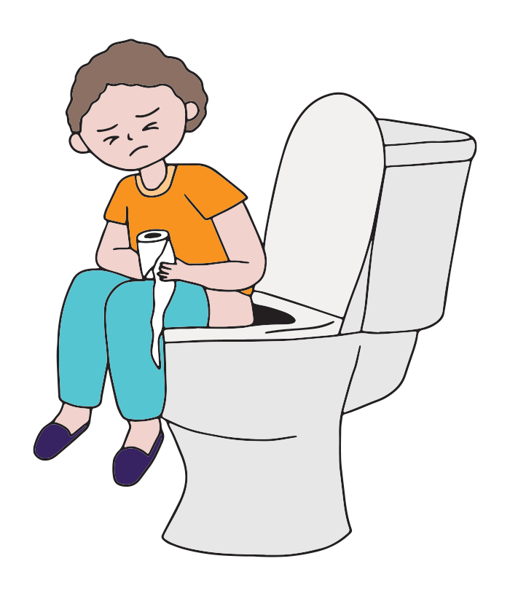
Paediatric Crohn’s and Colitis
Hospital Audit and Patient Experience Australia

Slide 26
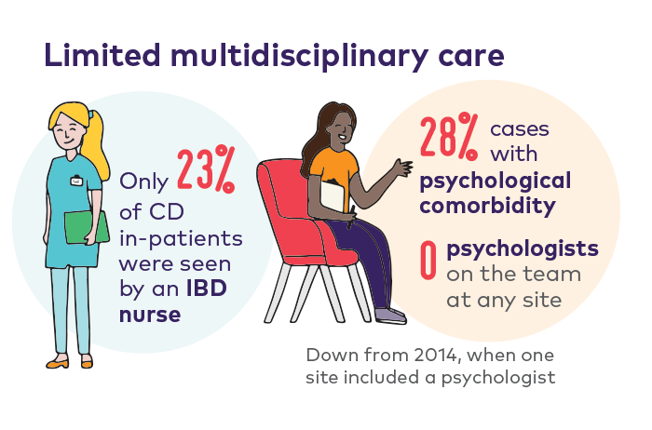
Notes:
Hospital audit compared data in 2014 with new data collected in 2021

Slide 27
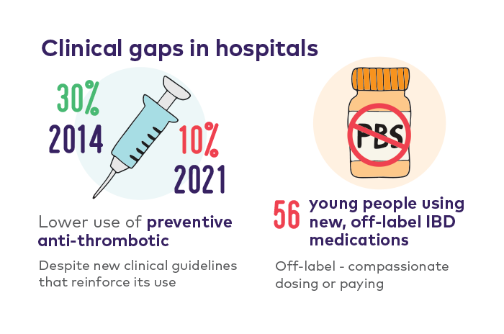

Slide 30
Thank you
Young people with IBD and their parents and carers
Associate Professor Edward Giles and the members of the Project Advisory Committee
Hospital site leads and clinical auditors
Jo Maggs – ethics Support Monash Health
CCA team
Leanne Raven
Stephan Moller
Gauravi Gawade
Juliet Matskarofski-Bogoevska
Full reports on CCA website after 30 May 2024
Notes:
I would like to acknowledge and especially thank the more than 300 parents carers and young people who participated in providing data, our advisory committee members, hospital staff that undertook clinical audit and the project team at CCA. Full reports will be available on our website after 30 May

